Slide 1

Clarilux Chatbot
Next-Gen Enterprise RAG Architecture powered by Gemini 3 Flash & FastAPI

Slide 2

Mission & Intelligent Data Flow
Clarilux bridges the gap between raw conversational AI and proprietary data. By anchoring the Gemini 3 Flash model in verified organizational documents, we eliminate hallucinations.
The system provides a secure, fast, and scalable bridge for teams to query internal knowledge bases with sub-second latency.

Slide 3






Primary Strategic Objectives
Intelligent Dialogue
Data Privacy
High Scalability
Local RAG execution ensures documents never leave the secure environment.
Containerized FastAPI backend built for enterprise concurrency.
Native conversational AI capabilities using Gemini's high-reasoning preview model.

Slide 4
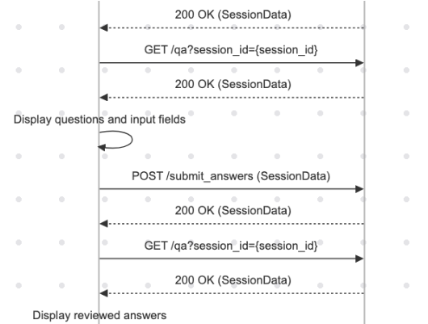
The Enterprise Technical Stack
FastAPI: High-performance async backend for sub-second request handling.
Gemini 3 Flash: 1M+ context window with frontier-level reasoning speeds.
Docker: Containerized deployment for environment parity across all clouds.

Slide 5
Architecture & Flow
A deep dive into the RAG pipeline and retrieval logic.

Slide 6
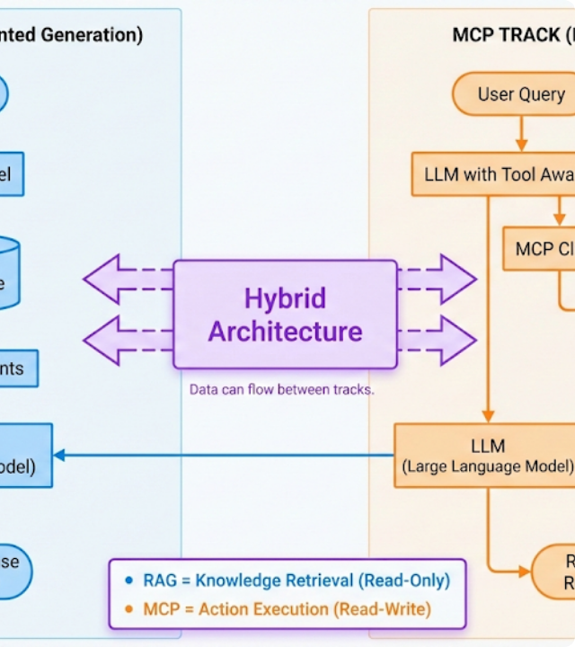
Modern RAG Pipeline Flow
Our RAG architecture follows a structured four-stage process to ensure grounded answers:
Ingestion: Reading .txt and .md files into memory.
Processing: Chunking with 250-word windows.
Retrieval: Scoring based on query intersection.
Synthesis: Prompt augmentation for the AI.

Slide 7


System Execution Lifecycle
1. Initialization
2. Request Loop
Loading env variables, validating API keys, creating the global chat session, and pre-loading document chunks into a high-speed memory cache.
Validation of user message, performing keyword scoring, building the RAG context prompt, and handling Gemini API retries.

Slide 8
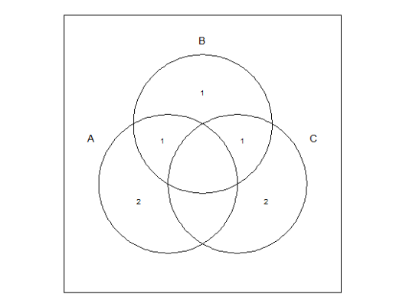

Proprietary Scoring Logic
Top 3
Relevant Excerpts

Slide 9
Core API Endpoint Registry
Path | Method | Description
/ | GET | Serves the static web chatbot interface.
/api/chat | POST | Main inference endpoint for RAG & Gemini logic.
/api/reset | POST | Flushes history and initializes a new session.

Slide 10

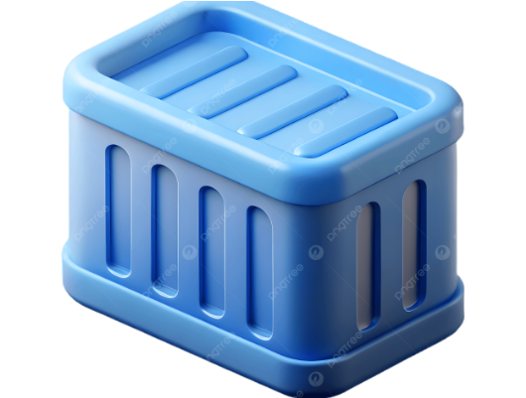
Dockerized Deployment Benefits
Parity: Guarantees the same runtime environment on any server.
Isolation: Bundled dependencies ensure zero system conflicts.
Ready for Scale: Simplified orchestration for AWS, Azure, or GCP.

Slide 11
Future Strategic Roadmap
Multi-Tenant
Vision AI
Session-based isolation for parallel users.
Multimodal support for PDF and Image analysis.
Vector DB
Hot-Reload
Transition to semantic embedding search.
Real-time file watchers for document updates.

Slide 12
Questions?
Thank you for your time. Let's discuss the future of Clarilux.

